Slide 1
PREDICTING EARLY ONSET OF DIABETES
ENEL – 645 Winter 2021
DATA MINING & MACHINE LEARNING
Group - 13
Presented By : Anita Das (30123166)
Archi Patel (30119318)
Kishan Suthar (30135955)
Ratna Sai Pravallika (30137702)
Vrunda Adhvaryu (30129384)
04-11-2021

Slide 2
Content
Overview
Data distribution and exploration
Grid search and selection of Hyperparameter
FNN model
Results
Conclusion

Slide 3
Introduction
According to a report by the International Diabetes Federation in 2017 , there were 425 million diabetics in the world at the time, and it was also concluded that the number will increase to 625 million by 2045.
Diabetes is caused when the proportion of sugar and glucose increases in blood.

Slide 4
Motivation and Significance of Diabetes Prediction System
With time, threat of diabetes is increasing on mankind, especially on elders.
Several signs and symptoms of Diabetes includes frequent urination, increased thirst, mood swings, weight loss, fatigueness, increased hunger and many more.
Our motivation is to identifying the diabetes in an early stage accurately to save the human life.

Slide 5
Overview
We used the dataset of The Pima Indian Diabetes Dataset.
In this project, we are using Fully Connected Network (FNN).
We have compared ML techniques with Deep Learning techniques achieved an accuracy of 76.6%.

Slide 6
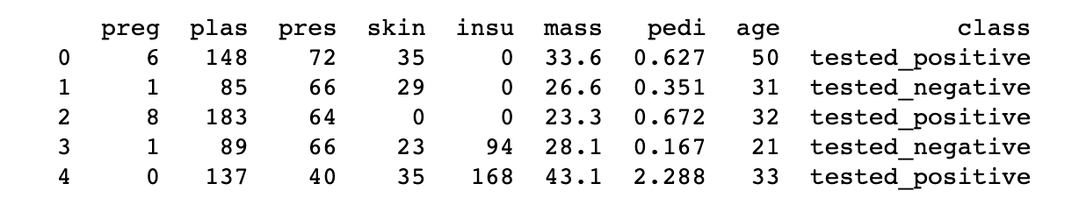
Dataset used
We have used Pima Indian Diabetes Dataset .
The dataset is a medical data of people residing near Phoenix, Arizona of USA.
Total we have 768 data each containing 9 different fields like no of pregnancies, level of plasma in blood,
blood pressure, skin thickness, insulin, body mass index, pedigree function, age and the class which it belongs to.
The data distribution is: Tested positive for diabetes – 268 patients, Tested negative for diabetes - 500 patients.
We have two classes viz. tested_positive and tested-negative.

Slide 7
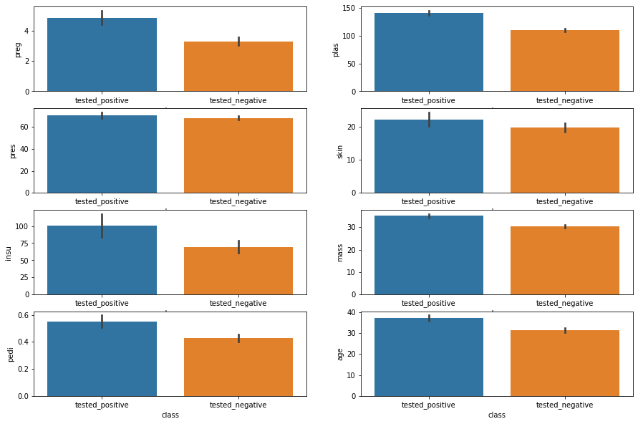
Comparison of features with labels – Bar Plot

Slide 8
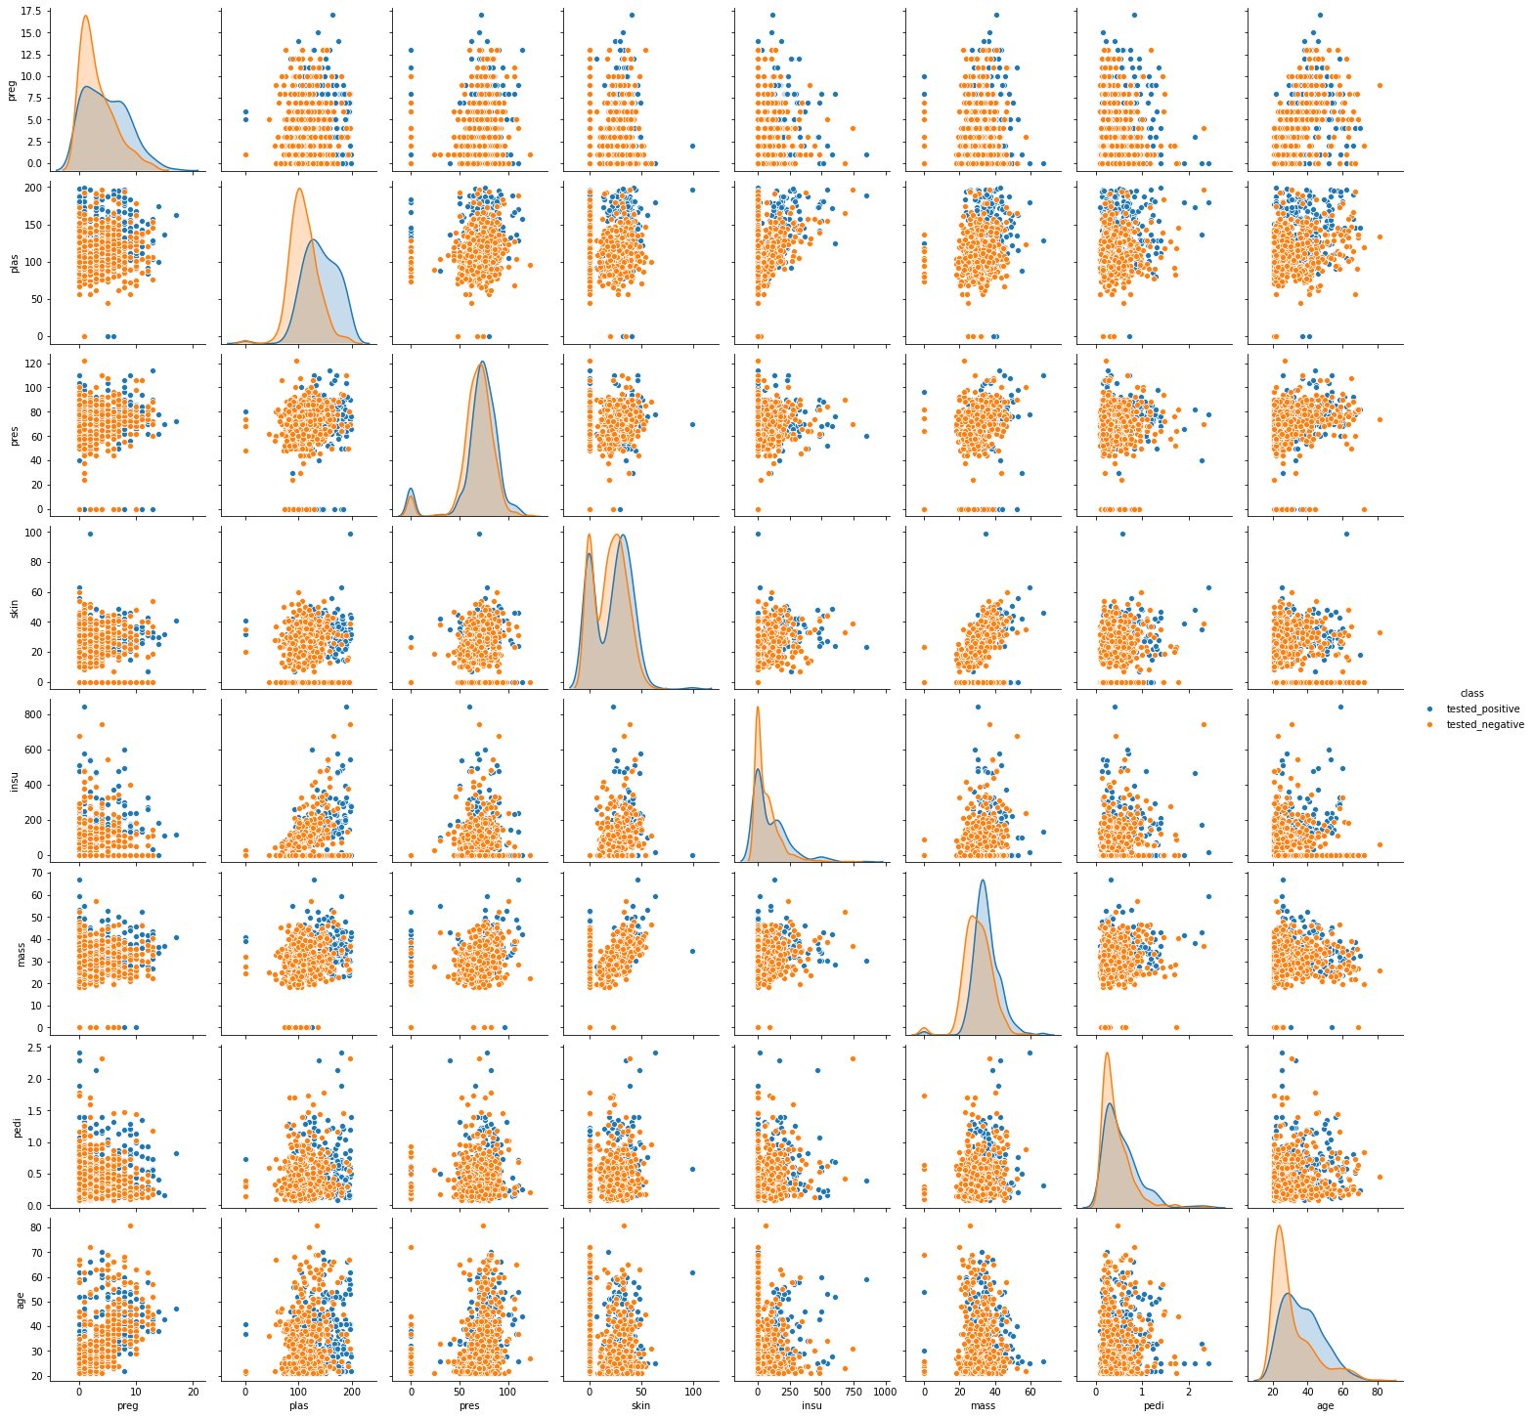
Pairplot

Slide 9
Data Preprocessing
Represented data labels into 0,1 where 1 represents tested_positive and 0 represents tested_negative or vice versa.
Data is split into 75% training set, 15% validation set and 10% testing set.
Whole data is represented into one-hot encoding.
Data scaling is done using Standardization technique.

Slide 10
ML Techniques with GridSearch

Slide 11
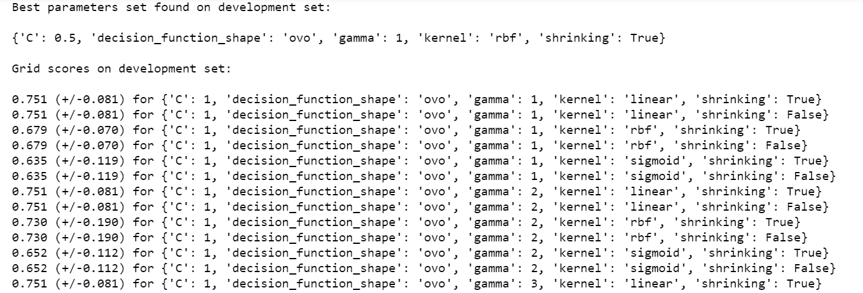
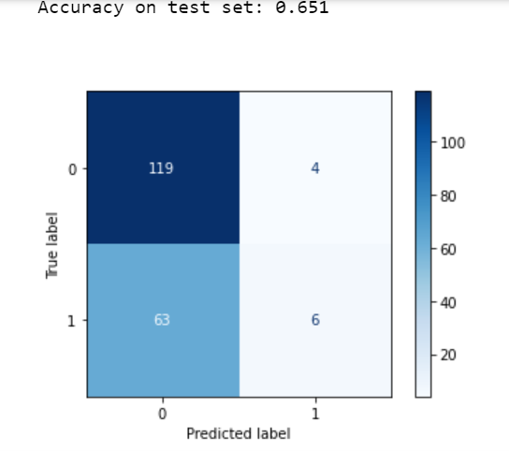
Support Vector Machine (SVM)

Slide 12
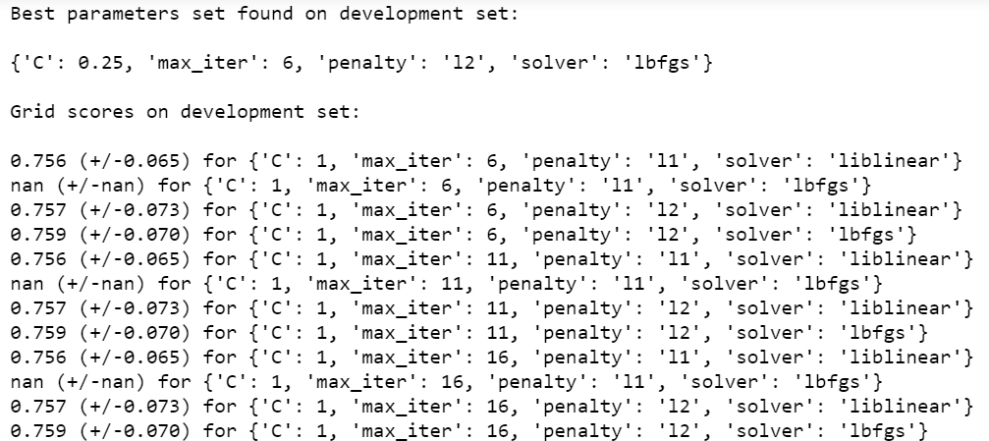
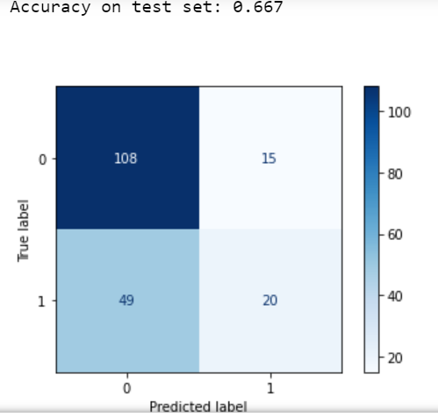
Logistic Regression (LR)

Slide 13
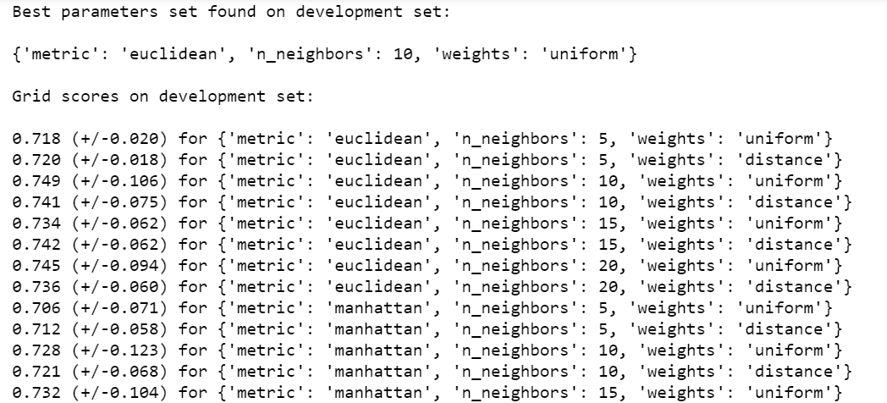
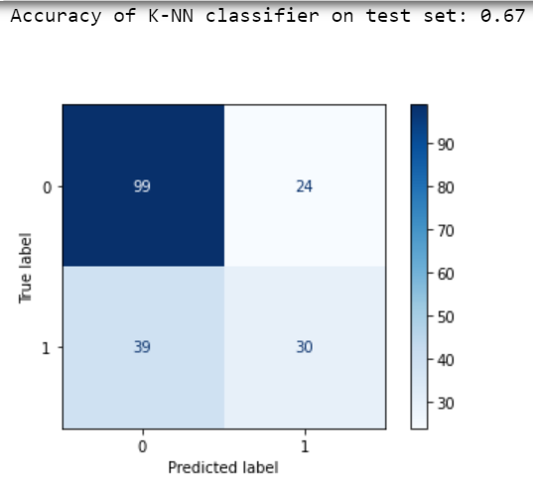
K-Nearest Neighbour (KNN)

Slide 14
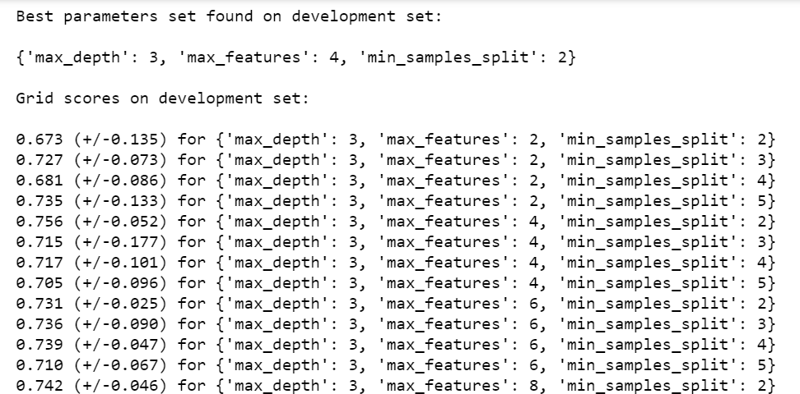
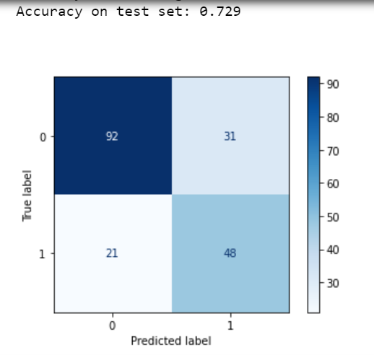
Decision Trees (DT)

Slide 15
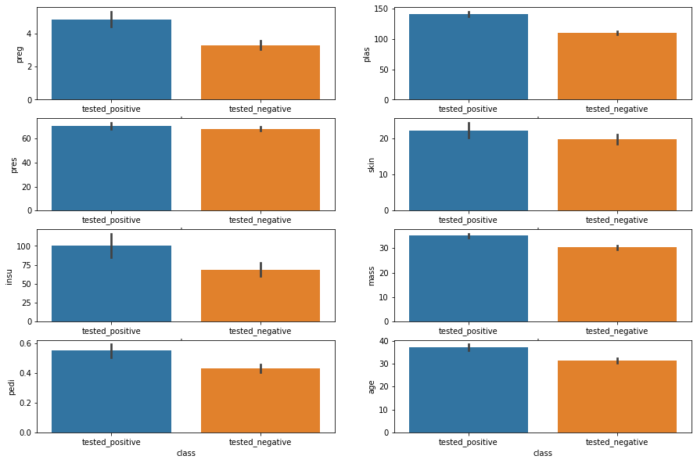
Data distribution and Exploration

Slide 16
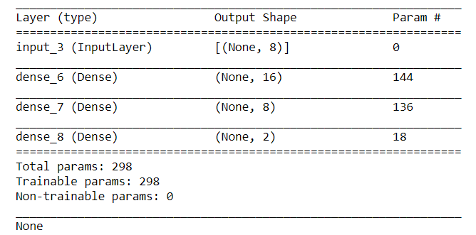
FNN model
We are using .csv file as our input.
Features has no co-relation with each other. FNN would be the best fit deep learning method.
We experimented a lot with our model.
Model Summary:

Slide 17
FNN (Fully Connected Neural Network)

Slide 18
FNN model
Relu used for all hidden layer, Softmax for output layer.
Loss : Binary cross-entropy
Stochastic gradient descent
Call-backs: Early Stop, learning rate schedular

Slide 19
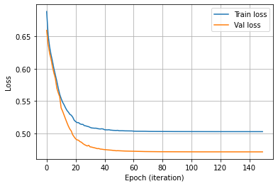
Validation and Training Loss
Validation Loss 47%
Train loss 52%
Here we can see, training is going down and validation is also going down.
Validation loss is below than the training loss.
Validation usually indicates that training data is harder to model than validation data.
Train and validation loss decrease upto 20 epochs after 20 they remain constant.
Finally we can say, validation loss is about 0.47 and train loss is about 0.52

Slide 20
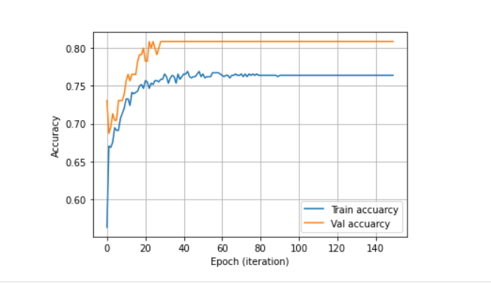
Accuracy Plot

Slide 21
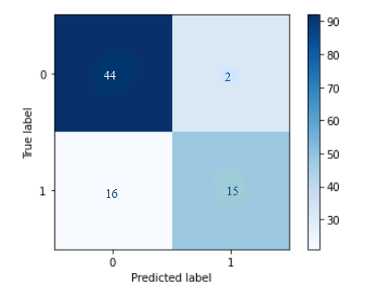
Confusion Matrix

Slide 22
Results

Slide 23
Results
Accuracy Rate: 0.7662
Misclassification Rate: 0.2337
ROC AUC Score: 0.7202
 | Precision | Recall | F1-score | Support
0 | 0.73 | 0.96 | 0.83 | 46
1 | 0.88 | 0.48 | 0.62 | 31

Slide 24
Conclusion
Performed experiments on Pima Indians Diabetes Database.
SVM, KNN, Logistic Regression and Decision Tree algorithms resulted an accuracy to a range between 64 – 72%.
Achieved an accuracy of 76.6% by using a deep learning technique with FNN model.

Slide 25
Thank You

